Slide 1
Introduction to Scientific Computing Sample Final Projects

Slide 2
Undergrad projects

Slide 3
Python Cameron County Population Modeling
Alvaro Garcia

Slide 4
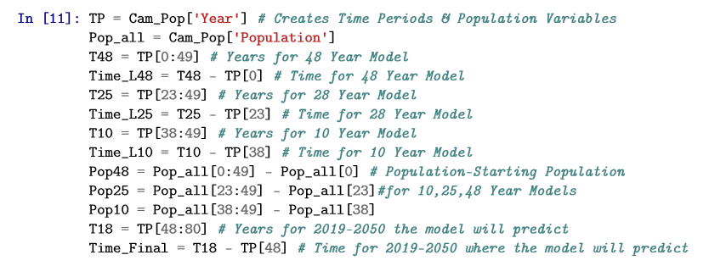
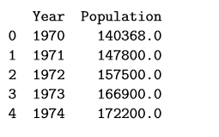
Methods – Data Preparation
Acquired Population Data – 1970-2018
Used Pandas to create data frame and set exponential equation variables

Slide 5
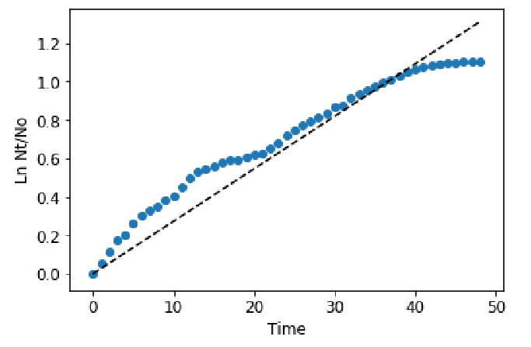
Methods – OLS Regression on the Exponential Growth Equation
Using Statsmodels package, OLS regression was performed on the natural log of population over starting population versus time.
This was also done for linear models
Difference between population and starting population vs time
Using Statsmodels predict function, population projections were made
This was done for:
1970-2018
1993-2018
2008-2018

Slide 6
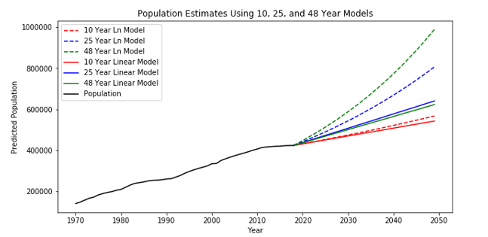
Results – Population Model

Slide 7
RGV Ecoregion Analysis
Bridgett Collis

Slide 8
Analyzing Land Use in the RGV and Fort Brown Resaca Watershed using TPWD Ecoregions
Texas Parks and Wildlife Ecological Systems Classification and Mapping Project
The Western Gulf Coastal Plain and The Southern Texas Plains ecoregions shapefiles
Texas County Boundaries Detailed shapefile from GIS-TxDot
The ecoregion shapefile was clipped using the clip feature to the following shapes:
Cameron county
Hidalgo county
Willacy county
Starr county
RGV
Fort Brown resaca watershed.

Slide 9
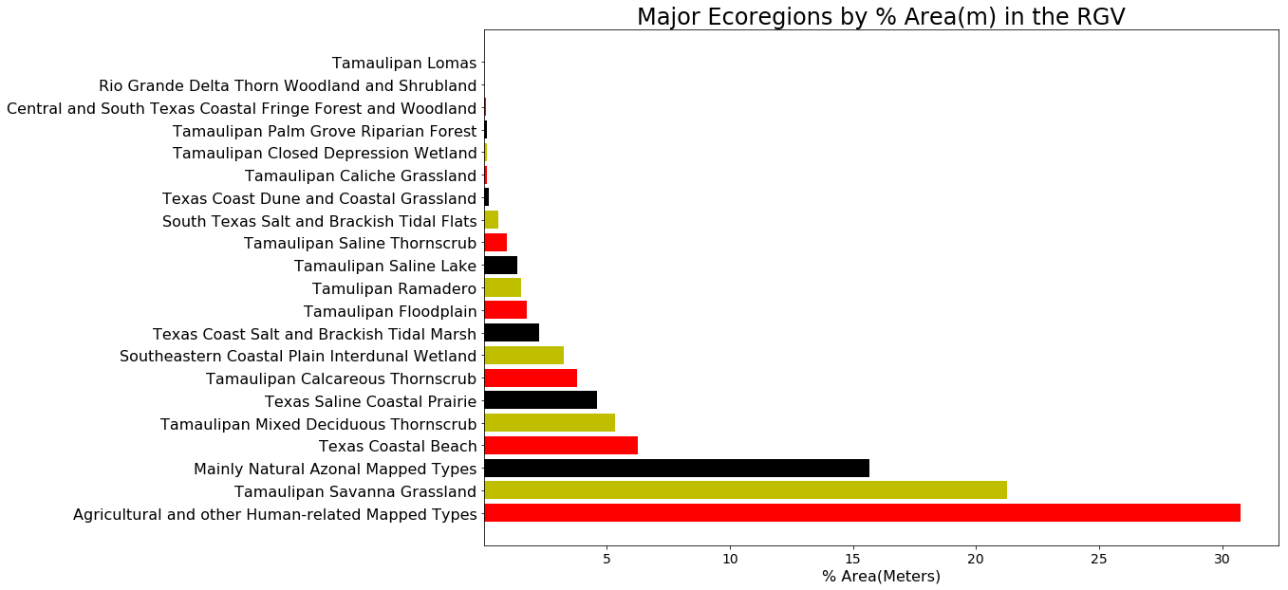
5.3%
15.7%
6.3%
21.2%
30.7%

Slide 10
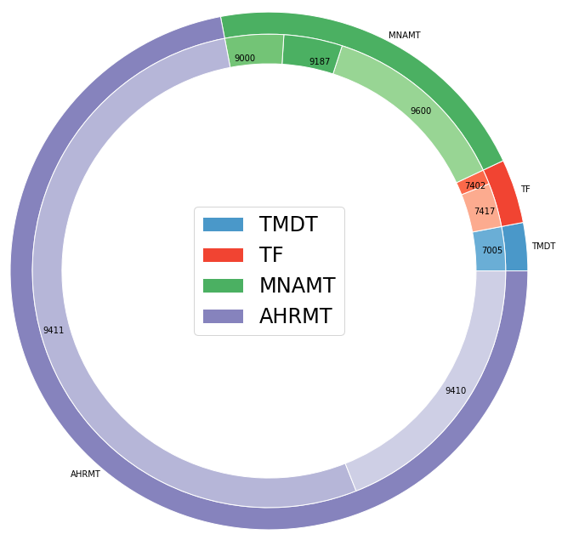
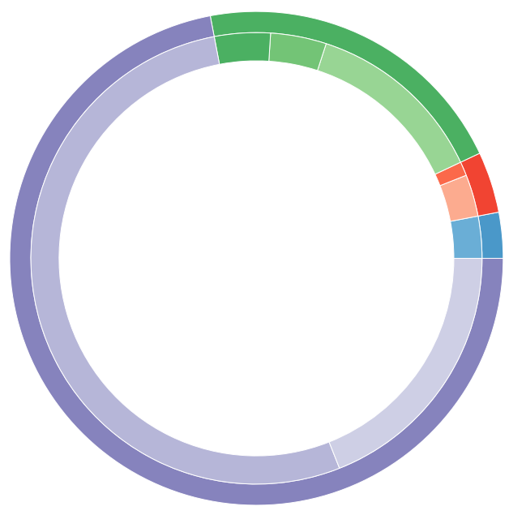
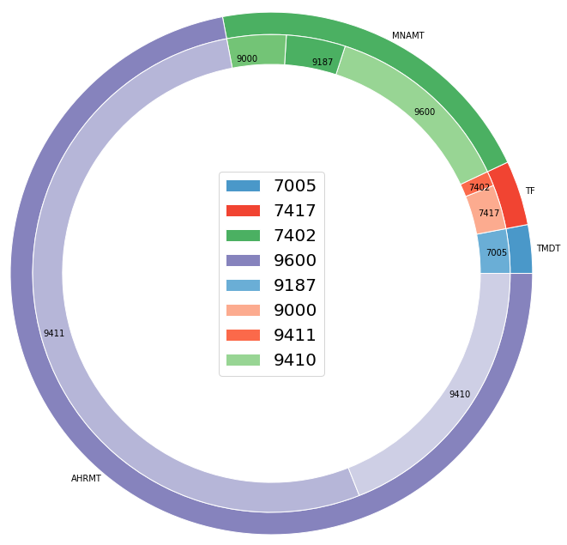
Fort Brown Resaca Watershed Ecoregions (% Area in Meters)
: 3 % Tamaulipan Mixed Deciduous Thornscrub
MNAMT
: 3 % Clayey Blackbrush Mixed Shrubland
: 4 % Tamaulipan Floodplain
: 3 % Floodplain Herbaceous Wetland
TF
: 1 % Floodplain Evergreen Forest and Woodland
AHRMT
TMDT
: 21 % Mainly Natural Azonal Mapped Types
: 13 % Open Water
: 4 % Disturbance Grassland
: 4 % Barren
: 72 % Agricultural/ Human-related Mapped Types
: 53 % Urban Low Intensity
: 19 % Urban High Intensity

Slide 11
Graduate projects

Slide 12
Phonology and Syntax
Red-Crowned Amazon Parrot
Abigail Pozulp

Slide 13
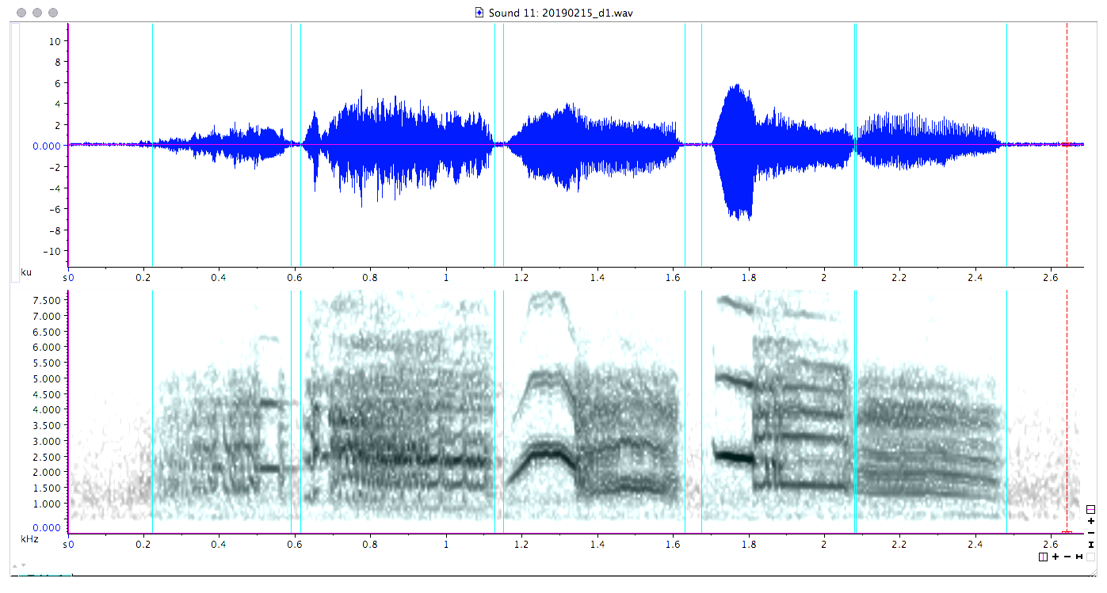
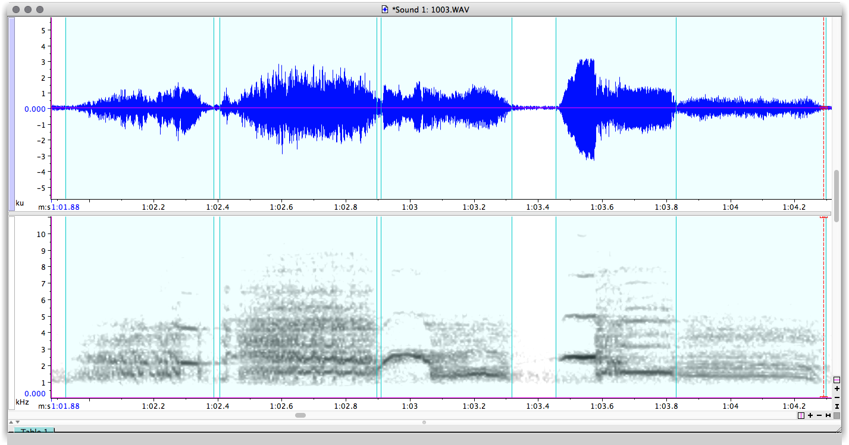
Phonology
34 unique signals manually classified with the use of audio and spectrographic visual representation
94 duets ranging from 4 to 15 signals in length

Slide 14
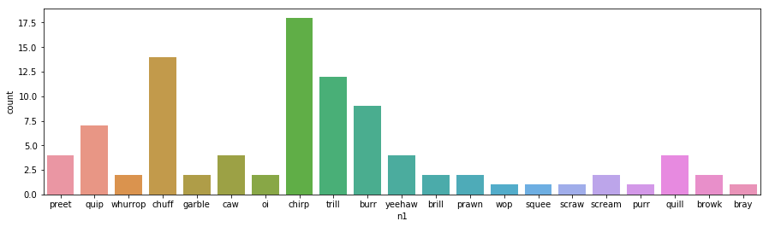
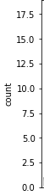
Seaborn Countplot there aren’t many options for visualizing categorical data

Slide 15
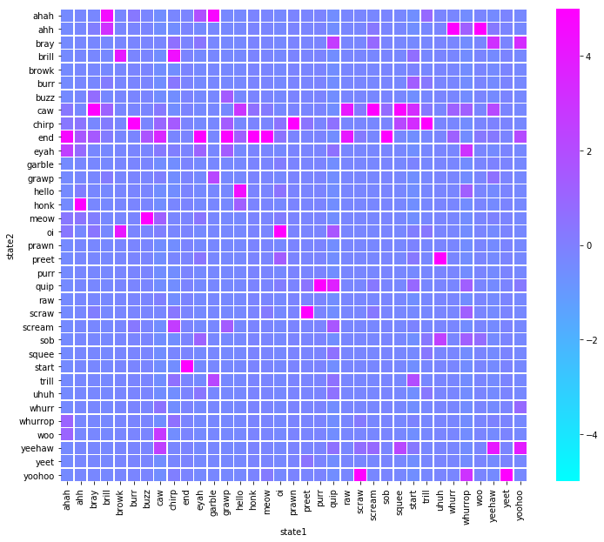
Observed transition probabilities

Slide 16
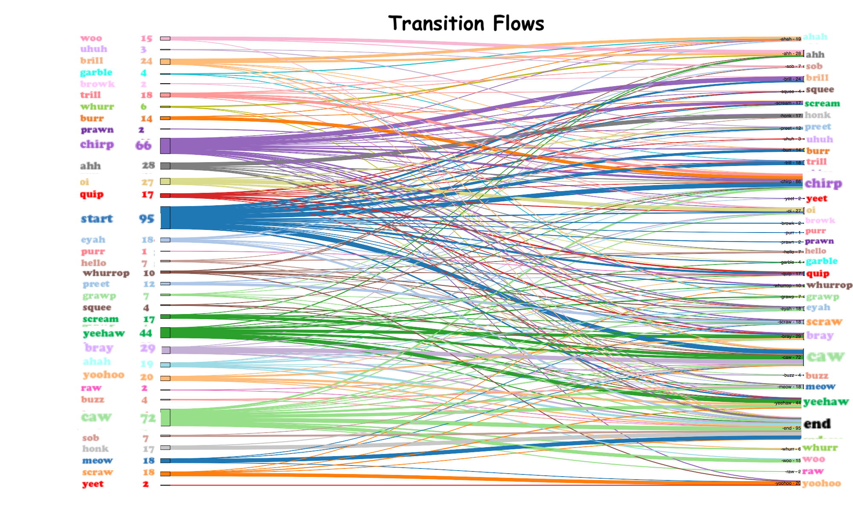

Slide 17
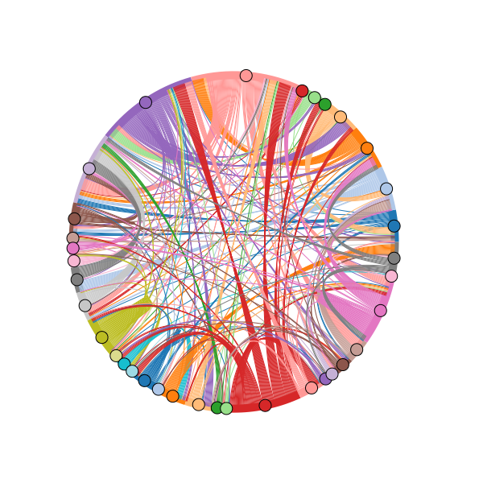
Circular Transition Flows Purple--Chirp Peach--Caw Pink--Yeehaw Red--Start Puce--Oi

Slide 18

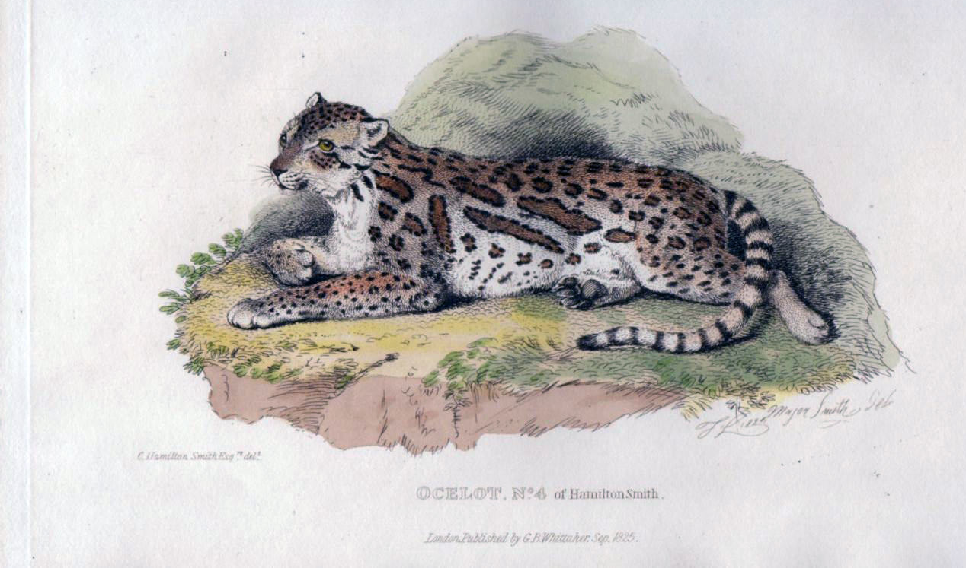
Using Vegetative Cover to Estimate Occupancy of Bobcats in South Texas
T. Miles Hopkins

Slide 19
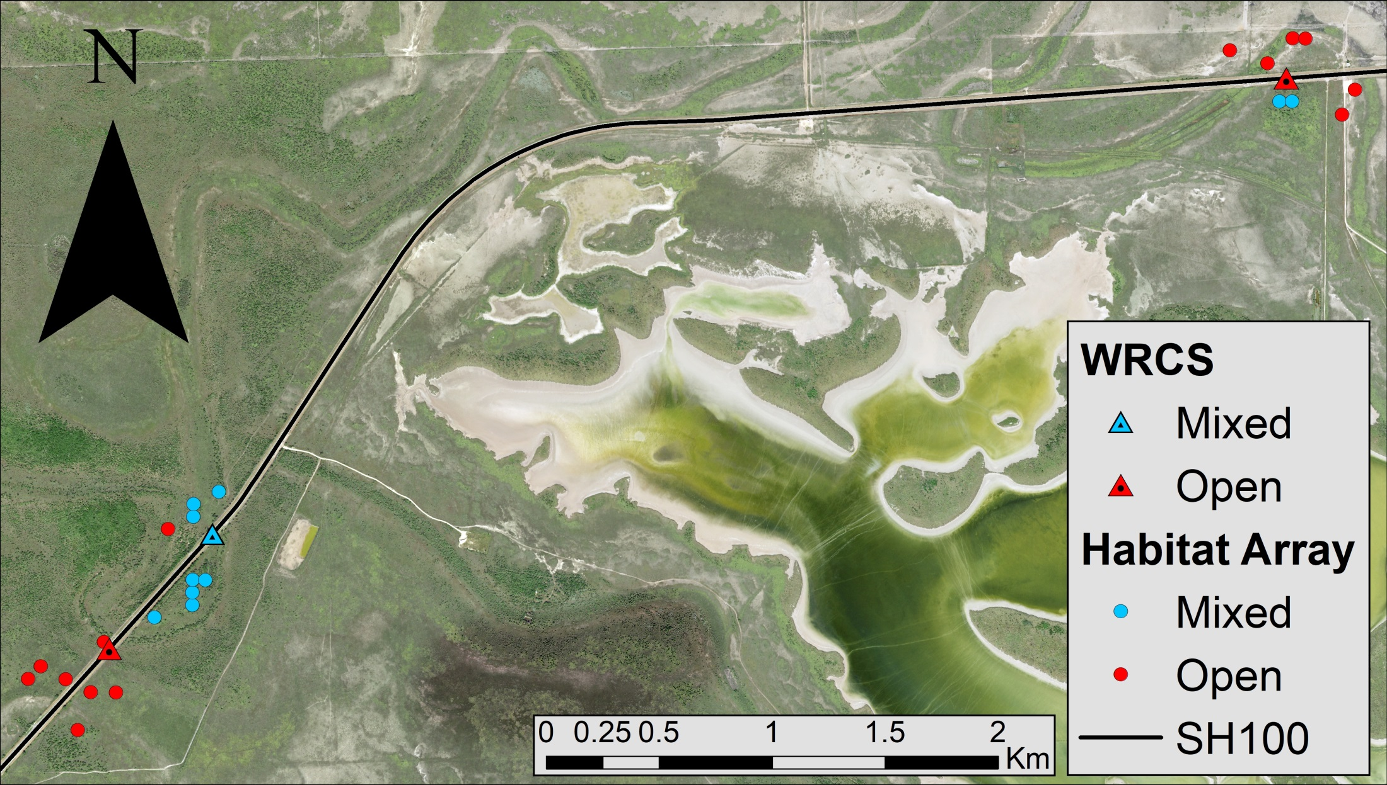
Vegetation Cover and Camera Array
Camera array to monitor wildlife crossing structures (WCS) on SH100
Using control sites to create an occupancy model surrounding SH100
Chose bobcats as a surrogate for ocelots
WCS

Slide 20
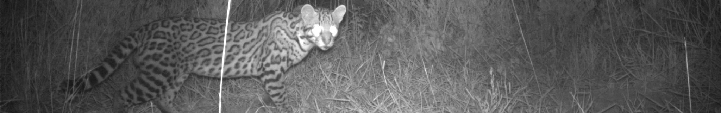
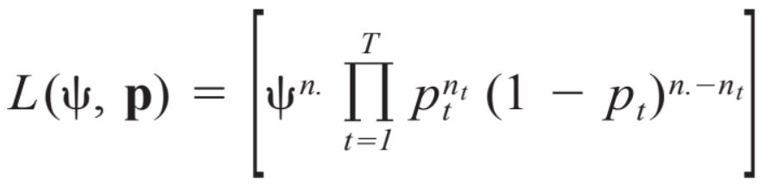
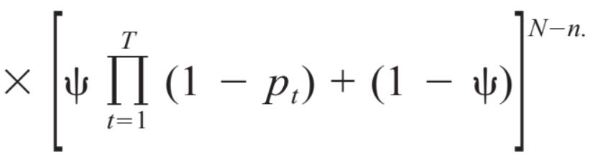
Occupancy Model
Occupancy: probability a patch is occupied by a species
Used MacKenzie et al. (2002) approach
Detection probability <1
Completed Steps
Presence/absence database based on canopy cover
Use bootstrap averages to determine ψ
ψ is influence of canopy cover
Create occupancy model

Slide 21
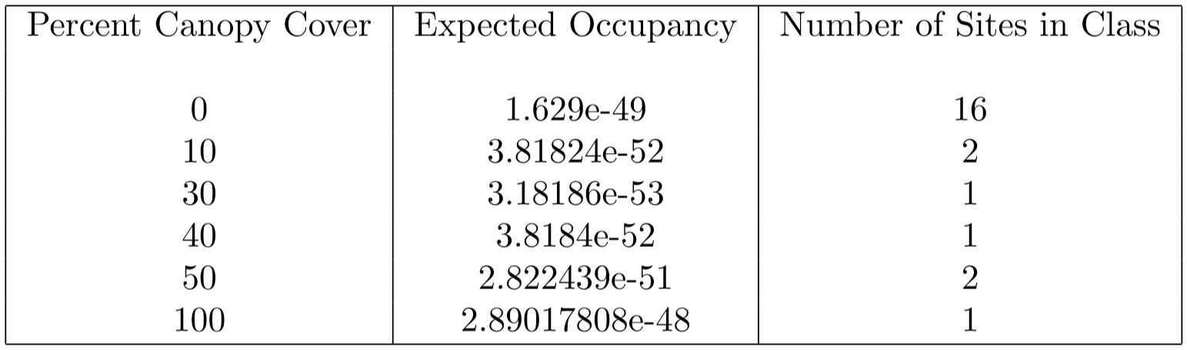
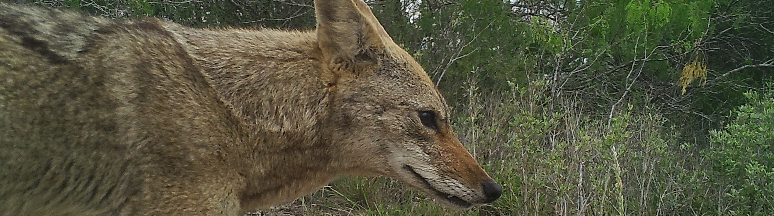
Results

Slide 22
Results
All results are effectively zero
Abnormal for this type of analysis
Expected due to data used
Future analysis should be more successful

